Slide 1
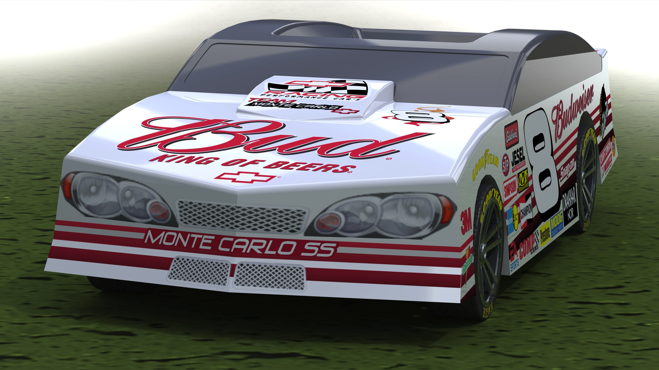
Sales Regional Manager
Independent agent

Slide 2
Overview
Company
Opportunity
Organic Campaign
Region
Growth
Next Steps

Slide 3

DC LABS LLC
Portland Oregon

Slide 4
DC LABS LLC
Formed in 2012
Limited Liability Corporation registered in the State of Oregon
Partners
Dan Freeman – Programmer Specialist
Chae Pak – Product Designer
App development and Toy manufacturing specialty
Primary focus Apple iPhone and iPod Touch apps
Plastics manufacturing
Development Partners in China and India
3D Modeling Partner in Detroit MI

Slide 5
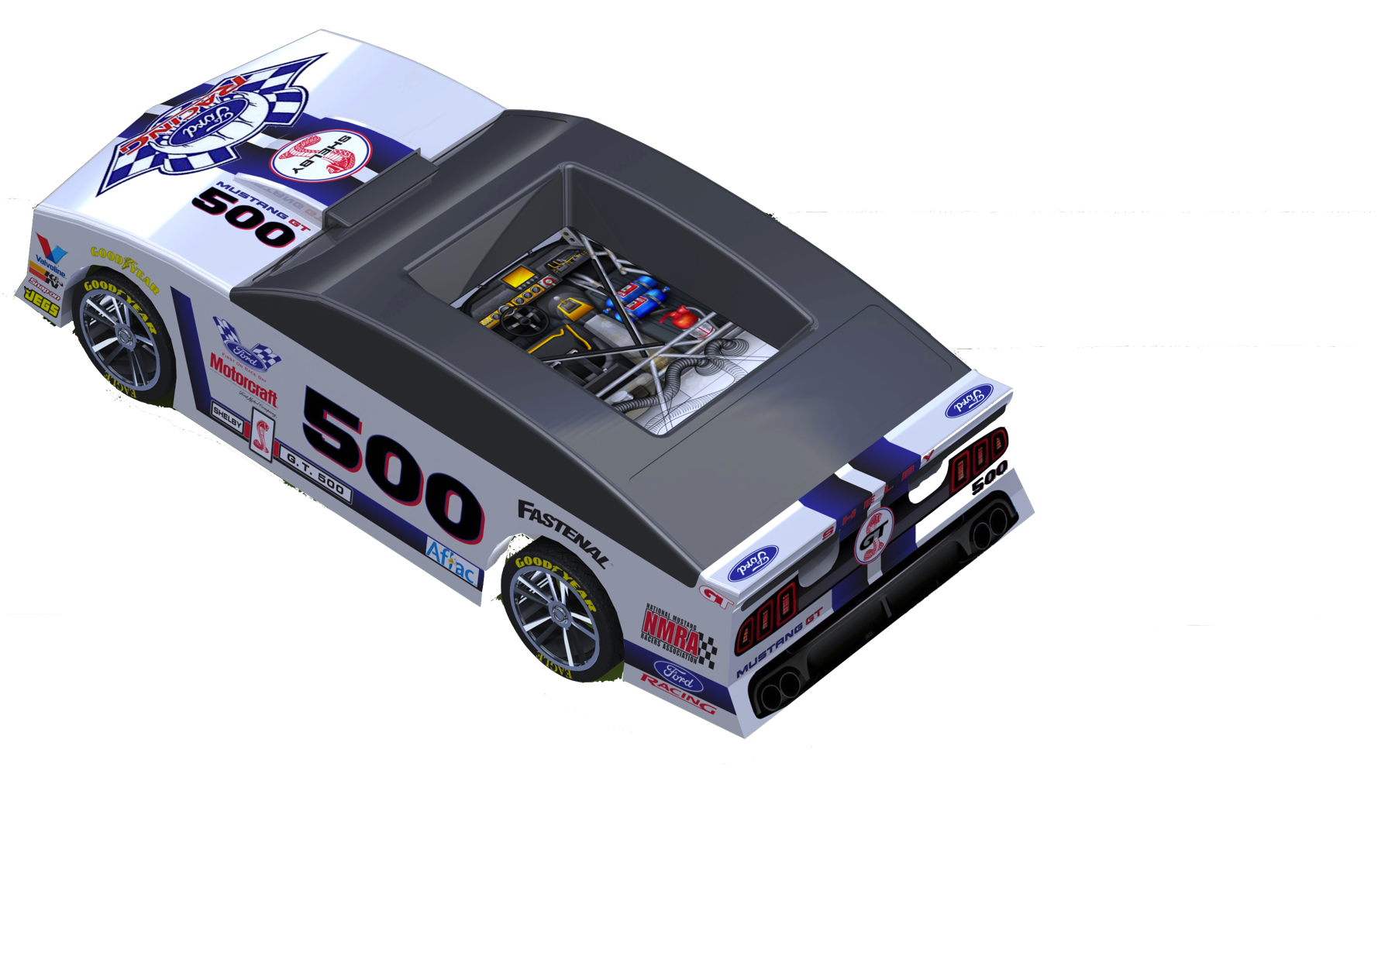
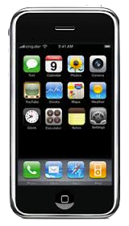
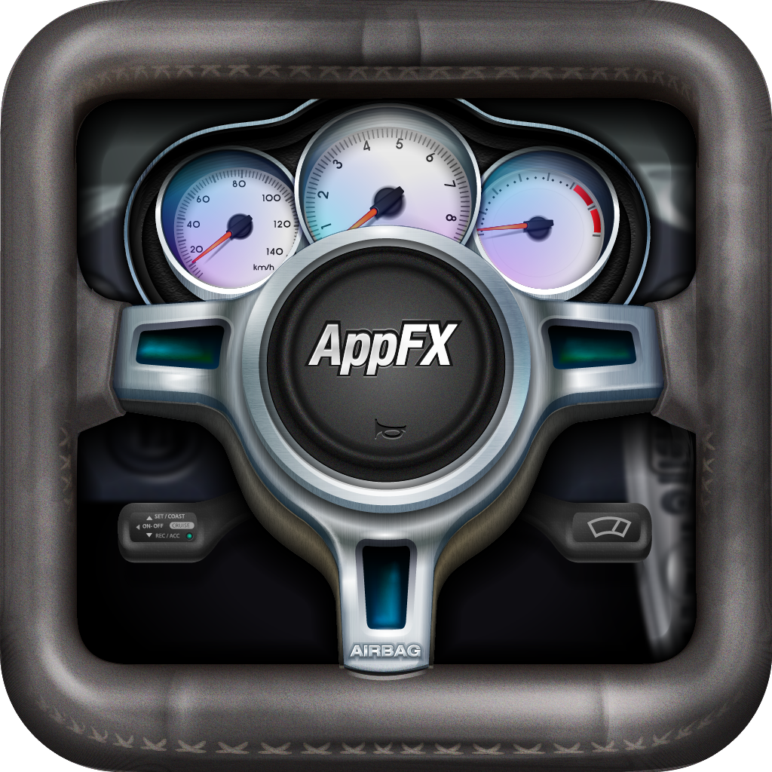
Opportunity
FX Driver and FX Car

Slide 6
Opportunity
Patent Pending Product
FX Car (Toy) and FX Driver (Integrated App)
Reimagined Toy Car that integrates an iPhone
Android version coming soon!
Two modes to play game
Driver Mode and Manual Mode
Quality Sounds and Physics Graphics in App
Toy Car is safe plastic
HDPE is the same as food containers
Toy Car has a silicon top for comfort and maximum grip for playing and interacting with the app

Slide 7
Opportunity
Target demographic is kids 3-7, however…
Organic Campaign target demographic is 17 to 24 year olds
We want the older sibling to make it cool, which is why we are not going the retail store route
Complete Package
Toy Car
Stickers
Masking Tape
Starting Price of the Car retail $19.99
Starting Price of App in AppStore $2.99
Online Storefront at Appfxtoys.com

Slide 8
Opportunity – Organic Campaign
Looking for Marketing Experts with their own company
Two phased sales approach
DC LABS will focus online and promote through digital channels
YOU, promote locally and profit from a promotion code specially designed for YOU
DC LABS only advertises and sells online and does not offer the same promo code or anything in that price class category
Our Goal: build the retail value of $20
Your Opportunity: Promo Code reduces the price 50%
Quality Toy for $10 (our cost for the product)
Promo Codes are time-based (90 days), no quantity limit

Slide 9
Opportunity – Organic Campaign
Own your region, on a first-come-first-serve basis
Commission Structure
$1 up to 5k pieces per month
$1.50 up to 10k pieces per month
$2 anything over 10k pieces per month
all inclusive jump in scale, so 5001 piece pays out at $7,501.50
We lose money on each sale but make money on accessories and online purchases without a promo code
Share Share Ideas with others like yourself in an online community
Social identities like Twitter and Instagram are shared as well
Check what your promotional earnings daily online
We pay bi-weekly for the two weeks prior

Slide 10
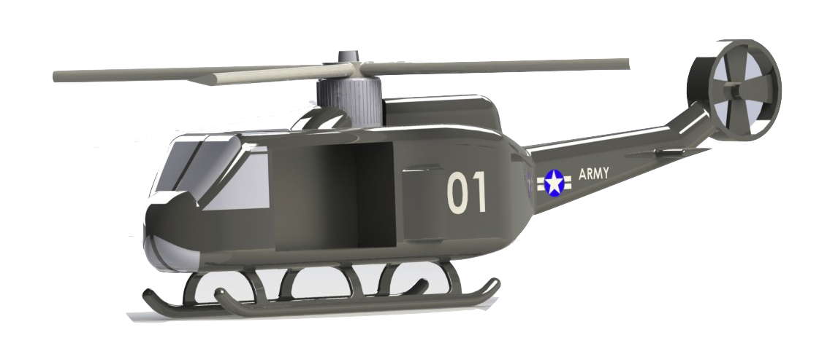
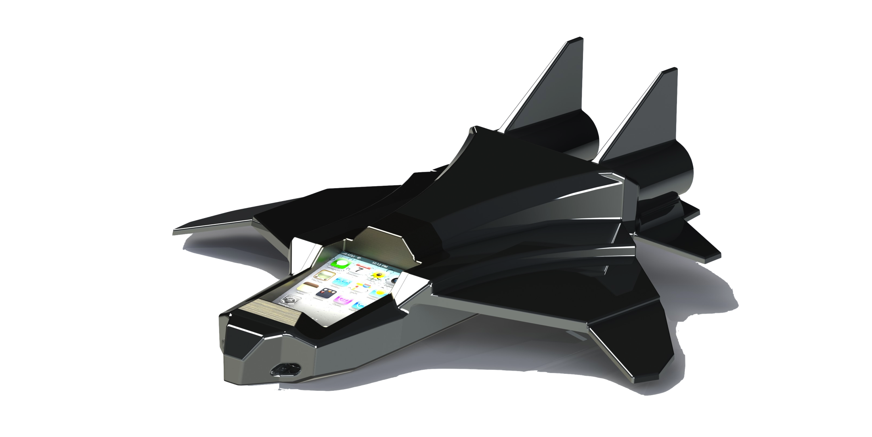
Next Steps
The Future

Slide 11
Next Steps
Sign Terms and Agreement and NDA
Product Information (Powerpoint)
Support community membership (zoho)
Understand Your Job
Read our website
Create an Entity; send us your Tax ID #
Invest in POS (Point of Sales) Materials
(we make zero profit; all at cost if purchased from DC Labs)
Used iPhone or iPod (est. $75 from eBay)
New Tablet ($175 for Android tablet any Retailer online)
5k flyers with promo code ($99 from Chromatic Printing in L.A.)
Shipping not included
5 pieces of the product ($45 from DC LABS)
Shipping not included

Slide 12
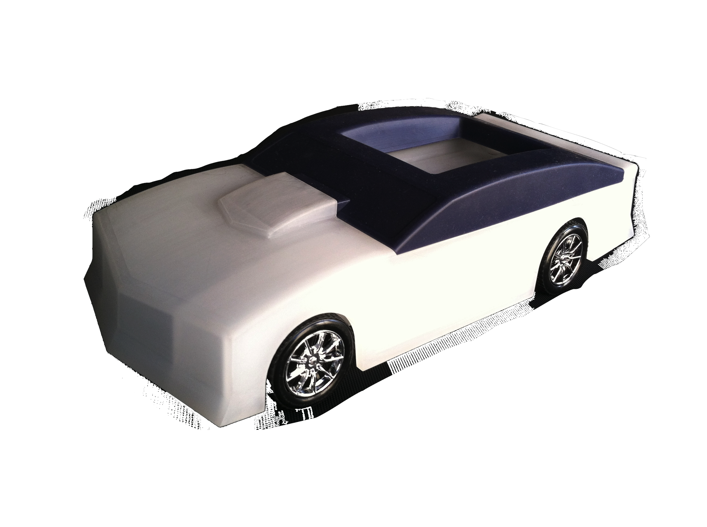
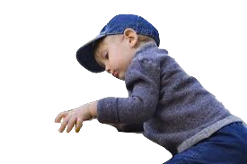
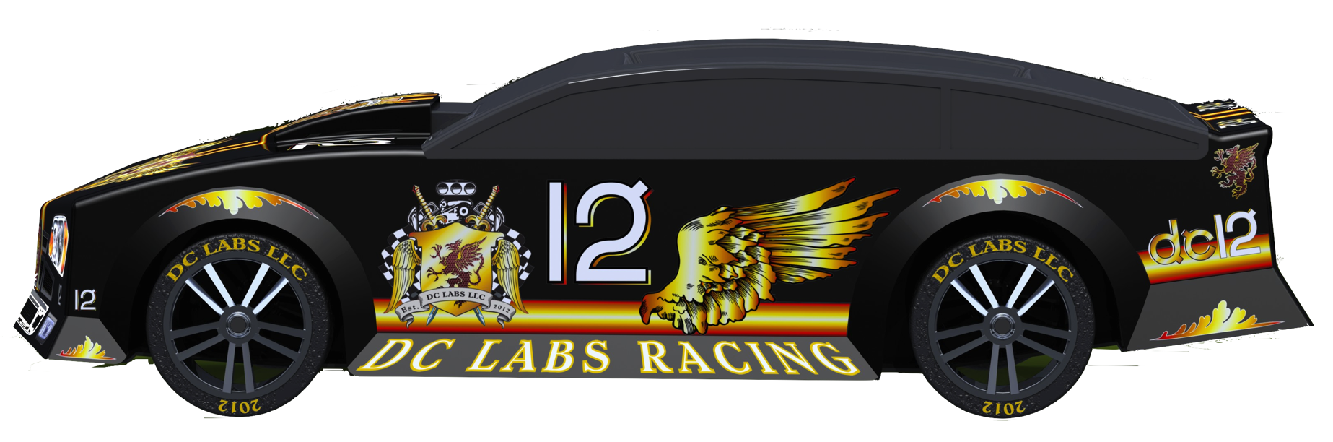
QUESTIONS
Our First Prototype

